Slide 1
Functions and Classes

Slide 2
Contents
Introduction to functions
Function prototyping
Call by value and Call by reference
Inline Functions
Friend Functions

Slide 3
Functions
A function is a group of statements that together perform a task
Reusable component.
Reduce the lines of code.
A function declaration tells the compiler about a function's name, return type, and parameters.
Data_type Func_name(Argument list)
A function definition provides the actual body of the function.
Data type func_name()
{
//Body of function
}

Slide 4
Function prototyping
In C++ all functions must be declared before they are used.
This is accomplished using function prototype.
Prototypes enable complier to provide stronger type checking. When prototype is used, the compiler can find and report any illegal type conversions between the type of arguments used to call a function and the type definition of its parameters.
It can also find the difference between the no of arguments used to call a function and the number of parameters in the function.
Thus function prototypes help us trap bugs before they occur.
In addition, they help verify that your program is working correctly by not allowing functions to be called with mismatched arguments.

Slide 5
Function Declaration
A function declaration tells the compiler about a function name and how to call the function.
Syntax :
return_type function_name( parameter list );
Note : Parameter List is optional

Slide 6
FUNCTION ARGUMENT TYPES
Actual Arguments:
The arguments passed during function calling time.
Formal Arguments:
The arguments specified in function definition.

Slide 7
FUNCTION ARGUMENTS EXAMPLE
int add(int x,int y)
x,y are formal arguments
{
}
return (x+y);
int main()
{
int a,b,sum;
cout<<“Enter 2 numbers: ”; cin>>a>>b;
sum=add(a,b); cout<<sum;
a,b are actual arguments

Slide 8
Function Definition
A function definition provides the actual body of the function.
Syntax:
return_type function_name( parameter list )
{
// body of the function
}

Slide 9
Function Calling
To use a function, you will have to call or invoke that function.
When a program calls a function, program control is transferred to the called function.
A called function performs defined task and when its return statement is executed or when its function-ending closing brace is reached, it returns program control back to the main program.
To call a function, you simply need to pass the required parameters along with function name, and if function returns a value, then you can store returned value.
Syntax:
Func_name();

Slide 10
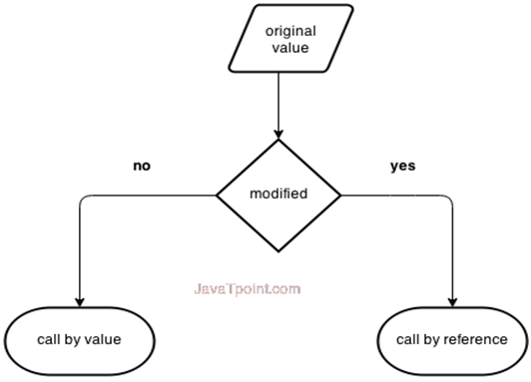
Call by Value Vs. Call by reference
There are two ways to pass value or data to function in C++ language: call by value and call by reference. Original value is not modified in call by value but it is modified in call by reference.

Slide 11
CALL BY VALUE
By default when we pass arguments to the function their value is passed.
It is just the value of actual arguments is copied/passed into formal arguments.
It does not allow to work on actual data.

Slide 12
CALL BY VALUE EXAMPLE
void swap(int x,int y)
{ int temp=x; x=y;
y=temp; } int main()
{ int a=4,b=6;
cout<<a<<"\t"<<b<<endl; swap(a,b);
cout<<"After Swap:"<<endl;
cout<<a<<"\t"<<b<<endl; return 0;
}
Output
4 6
After Swap: 4 6

Slide 13
CALL BY REFERENCE
The formal arguments are the reference variables.
It is not just the value of actual arguments is copied/passed into formal arguments.
It allow to work/modify on actual data.

Slide 14
CALL BY REFERENCE EXAMPLE
void swap(int &x,int &y)
{ int temp=x; x=y;
y=temp; } int main()
{ int a=4,b=6;
cout<<a<<"\t"<<b<<endl; swap(a,b);
cout<<"After Swap:"<<endl;
cout<<a<<"\t"<<b<<endl; return 0;
}
Output
4 6
After Swap: 6 4

Slide 15
INLINE FUNCTION
A function which is expanded at the line of call.
Means compiler replaces the function call with corresponding function code/definition.
An inline function is defined with inline keyword.
No overhead of function call and return.

Slide 16
INLINE FUNCTION
Makes a program run faster as no overhead of function call and return.
The program with inline function takes up more memory as statements are reproduced.
Syntax:
inline functionName(argument-list)
{ function body }

Slide 17
INLINE FUNCTION EXAMPLE
inline int cube(int x)
{ return x*x*x;
}
int main()
Output
Enter a number: 5 Cube is: 125
{ int n,ans;
cout<<"Enter a number: "; cin>>n;
ans=cube(n);
cout<<"Cube is: "<<ans;
return 0;
}

Slide 18
Making member function inline
Syntax:
Example:
inline return_type function_name();
inline int getvalue();

Slide 19
DEFAULT ARGUMENTS
These are default values provided when no values are passed in arguments during function call.
Default arguments are specified when function is declared.
In case, there is no function declaration, then at definition time you can specify default arguments.

Slide 20
DEFAULT ARGUMENTS DECLARATION TIME
int add(int x,int y=1);
int main()
{
int a=4,m; m=add(a);
Output
Sum is: 5
cout<<"Sum is: "<<m<<endl;
return 0;
}
int add(int x,int y)
{ return x+y; }

Slide 21
DEFAULT ARGUMENTS DECLARATION TIME
int add(int x,int y=1); int main()
{
int a=4,m; m=add(a,6);
Output
Sum is: 10
cout<<"Sum is: "<<m<<endl;
return 0;
}
int add(int x,int y)
{ return x+y; }

Slide 22
DEFAULT ARGUMENTS DEFINITION TIME
int add(int x,int y=1)
{ return x+y; }
Output
int main()
{
int a=2,m;
m=add(a,6);
Sum is: 8
cout<<"Sum is: "<<m<<endl; return 0;
}

Slide 23
RECURSION
A situation when function calls itself.
It seems like an infinite loop.
But a condition is there to get out of loop.
Function

Slide 24
RECURSION EXAMPLE
int fact(int n)
{ if (n<=1) return 1;
else
return n*fact(n-1); }
Output
Factorial is: 120
int main()
{ int f;
f=fact(5);
cout<<"Factorial is: "<<f<<endl;
return 0; }

Slide 25
FUNCTION OVERLOADING
Overloading refers to the same thing for different purposes.
Function overloading means we can use the same function name for creating different purposes.
It is also called polymorphism.
Note that only name of the function is same but argument list is different.

Slide 26
FUNCTION OVERLOADING EXAMPLE
int add(int x,int y)
{ return x+y; }
int add(int x,int y,int z)
{ return x+y+z; } double add(double x,int y)
{ return x+y; }
int main()
{ cout<<add(4,2)<<endl;
cout<<add(4,2,9)<<endl;
return 0;
}
Output
6
15
6.6
cout<<add(4.6,2);

Slide 27
NESTING MEMBER FUNCTION
Calling a function inside function is called nesting functions.
A member function can be called by using its name inside another member function of the same class
If a function requires a specific functionality which is already defined in another function then nesting of functions is done.
It is always better to use the already defined things rather than creating the new one.

Slide 28
NESTING OF FUNCTION EXAMPLE
int a,b;
void setData(int x,int y)
{ a=x; b=y; }
int add()
{ return a+b; }
void show()
{ cout<<add(); }
int main()
Output
6
{
setData(2,4);
show();
return 0;
}

Slide 29
Working with Classes

Slide 30
Objective
Structure Revisited
Introduction to Classes
Specify a Class
Defining member functions
Access Specifiers
Private Member functions
Array within a class
Memory allocation of an object
Object as function argument
Static Data Members & functions

Slide 31
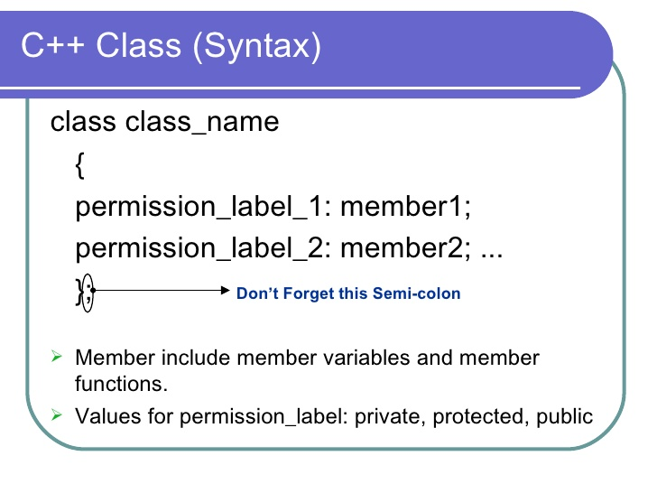
Introduction to Class
Class is a user define data type.
Class is a collection of data member and member function.

Slide 32
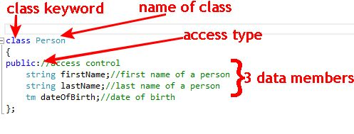
Specify a class

Slide 33
Defining member function
Member function Definition
Inside Class
Outside Class

Slide 34
Cont…
Inside Class definition
Class class_name
{
…….. ……. ………
public:
return_type funct_name(arg_list)//Function Definition
{
……
}
};

Slide 35
Cont…
Outside Class definition
Class class_name
{
…….. ……. ………
public:
return_type funct_name(arg_list); //Function Declaration
};
return_type class _name :: funct_name(arg_list) //Function Definition
{
……
}

Slide 36
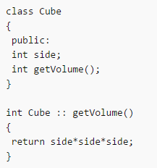
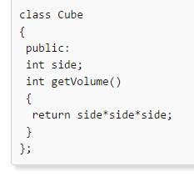
Cont…
Example Inside class definition
Example Outside class definition

Slide 37
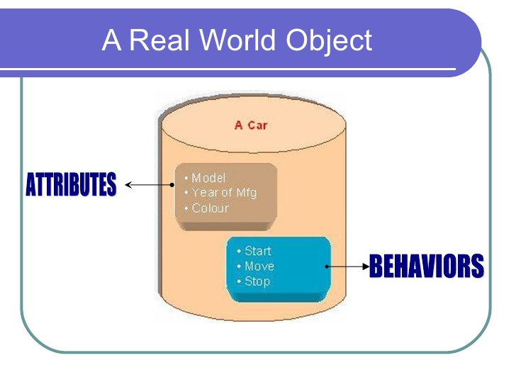
Object
Object is a class type variable.
Objects are also called instance of the class.
Each object contains all members(variables and functions) declared in the class.

Slide 38
Creating Object
Syntax:
Example:
Class_name Object_name;
cube cu;

Slide 39
Comparison between Class and Structure
Class
Structure
Keyword Class is used
Members of a class are private by default .
Keyword Struct is used
members of structure are public by default

Slide 40
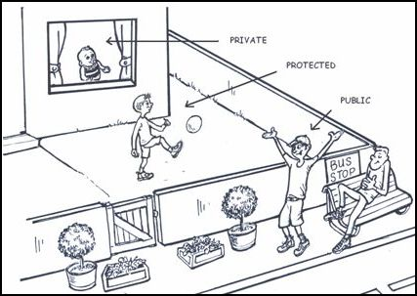
Access Specifiers
Access specifiers are keywords in object-oriented languages that set the accessibility of classes, methods, and other members.

Slide 41
Access Specifiers
Access Specifiers | Description
public | A public member is accessible from anywhere outside the class but within a program. You can set and get the value of public variables without any member function.
private | A private member variable or function cannot be accessed, or even viewed from outside the class. Only the class and friend functions can access private members.
protected | A protected member variable or function is very similar to a private member but it provided one additional benefit that they can be accessed in derived classes.

Slide 42
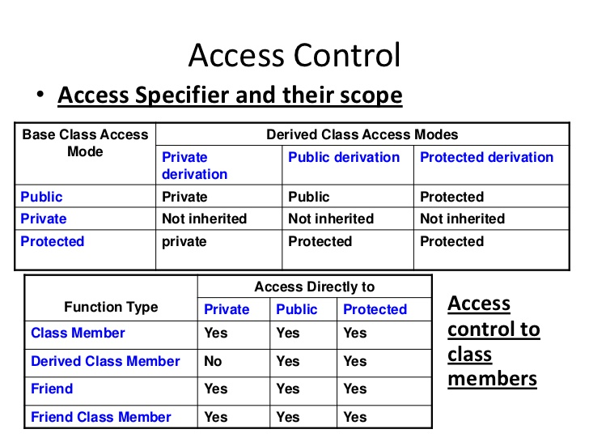

Slide 43
Private member functions
Private functions can only be called from within public member functions.
Even an object cannot invoke them using dot(.) operator.

Slide 44
Program on Private member functions
#include <iostream>
using namespace std;
class student
{
int marks;
void getvalue()
{
cout<<"enter marks";
cin>>marks;
}
public:
void display();
};
void student :: display()
{
getvalue();
cout<<"\nMarks are "<<marks;
}
int main()
{
student stu_obj;
stu_obj.display();
return 0;
}

Slide 45
Array within a class
When we are having an array variable defined with in the class this is known as array within the class.

Slide 46
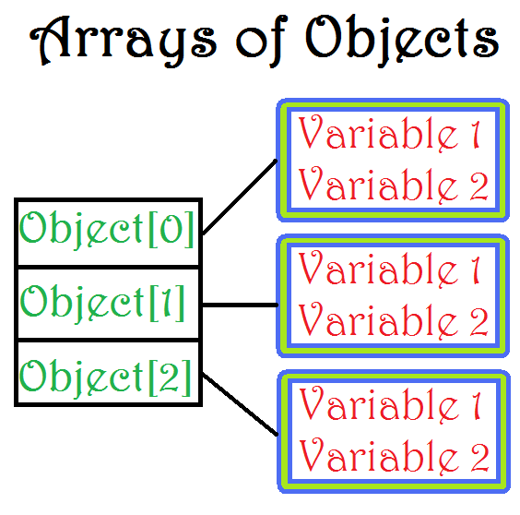
Array of Objects
An array of objects is a collection of objects of same class type that are stored in a contiguous memory location.
Syntax:
Class_name obj_name[size];

Slide 47
Program on array of objects
void display()
{
cout<<"\n Name"<<name;
}
};
int main()
{
person p1[10];
for(int j=0;j<=3;j++)
{
p1[j].getname();
p1[j].display();
}
}
#include <iostream>
using namespace std;
class person
{
char name[10];
public:
void getname()
{
cout<<"\nenter name";
cin>>name;
}

Slide 48
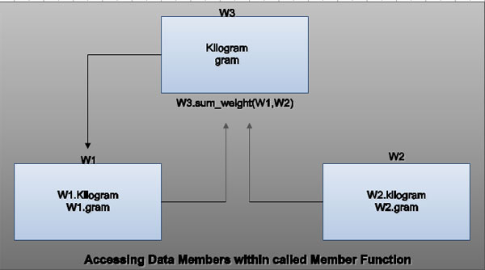
Object as function argument
The objects of a class can be passed as arguments to member functions as well as nonmember functions either by value or by reference.
When an object is passed by value:
a copy of the actual object is created inside the function. This copy is destroyed when the function terminates.
Moreover, any changes made to the copy of the object inside the function are not reflected in the actual object.
When an object pass by reference:
only a reference to that object (not the entire object) is passed to the function.
Thus, the changes made to the object within the function are also reflected in the actual object.

Slide 49
Cont..
Whenever an object of a class is passed to a member function of the same class, its data members can be accessed inside the function using the object name and the dot operator.
However, the data members of the calling object can be directly accessed inside the function without using the object name and the dot operator.

Slide 50
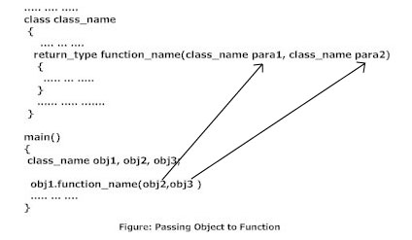
Syntax to pass object as argument

Slide 51
Program on Object as argument
#include <iostream>
using namespace std;
class getdata
{
int a=10,b=20;
public:
void value(getdata data,getdata data1)
{
int c;
c=data.a+data1.b;
cout<<"\n Sum is"<<c;
}
};
int main()
{
getdata data2,data3;
data2.value(data2,data3);
return 0;
}

Slide 52
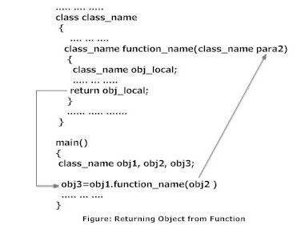
Returning Object

Slide 53
Program on returning object
add sum(add a1,add a2)
{
add a3;
a3.c=a1.a+a1.b;
return a3;
}
void show()
{
cout<<"\n Sum is"<<c;
}
};
int main()
{
add d;
d.getdata();
d=d.sum(d,d);
d.show();
return 0;
}
#include <iostream>
using namespace std;
class add
{
int a,b,c;
public:
void getdata()
{
cout<<"enter 1st value"<<endl;
cin>>a;
cout<<"enter 2nd value"<<endl;
cin>>b;
}

Slide 54
Friend function
A C++ friend functions are special functions which can access the private members of a class.
The declaration of friend function should be made inside the body of class starting with keyword friend.
Friend function is used when we need to operate on data of two or more objects of same or different classes.
Friend of the class can be member of some other class.
Friend functions are not member functions

Slide 55
Properties of Friend functions
It can't be called using object like other member function.
It is called like normal functions.
Private member can be accessed inside friend function using object name and dot(.) operator.
It can take multiple objects as parameter as required.
It should be declared in all the classes whose objects are sent as parameter.
It can be declared or defined in private, public or protected section of a class.

Slide 56
Program on friend function
#include <iostream>
using namespace std;
class add
{
int a,b,c;
friend void display(add);
public:
void getdata()
{
cout<<"Enter first number"<<endl;
cin>>a;
cout<<"Enter second number"<<endl;
cin>>b;
}
};
void display(add ad)
{
ad.c=ad.a+ad.b;
cout<<"sum is"<<ad.c;
}
int main()
{
add aa;
aa.getdata();
display(aa);
return 0;
}

Slide 57
Friend Classes
A friend class can access private and protected members of other class in which it is declared as friend.
It is sometimes useful to allow a particular class to access private members of other class.
Friendship is not mutual. If a class A is friend of B, then B doesn’t become friend of A automatically.
Friendship is not inherited.

Slide 58
Program on Friend Classes
class B {
public:
void show_value(A x) {
cout <<endl << "Accessing the value of friend" <<x.a;
}
};
int main()
{
A a;
B b;
a.getvalue();
b.show_value(a);
return 0;
}
#include <iostream>
using namespace std;
class A {
int a;
public:
void getvalue()
{
cout<<"Enter a value";
cin>>a;
}
friend class B; // Friend Class
};

Slide 59
Static Data members
We can define class members static using static key using static keyword.
When we declare a member of a class as static it means no matter how many objects of the class are created, there is only one copy of the static member.
A static member is shared by all objects of the class.
All static data is initialized to zero when the first object is created, if no other initialization is present.

Slide 60
Cont..
We can't put it in the class definition but it can be initialized outside the class as done in the following example by redeclaring the static variable, using the scope resolution operator :: to identify which class it belongs to.

Slide 61
Static member function
A static member function can be called even if no objects of the class exist and the static functions are accessed using the class name and the scope resolution operator ::.
A static member function can only access static data member, other static member functions and any other functions from outside the class.
Static member functions have a class scope and they do not have access to the this pointer of the class. You could use a static member function to determine whether some objects of the class have been created or not.

Slide 62
Program on static member
#include <iostream>
using namespace std;
class student
{
static int stnum;
public:
static void count()
{
stnum++;
}
void display()
{
cout<<"number of student is:\t"<<stnum<<endl;
}
};
int student :: stnum=1;
int main()
{
student s;
for(int i=1;i<5;i++)
{
student::count();
s.display();
}
return 0;
}

Slide 63
Member Dereferencing Operators
There are two pointer to member operators: .* and ->*.
The .* operator is used to dereference pointers to class members. The first operand must be of class type. If the type of the first operand is class type T, or is a class that has been derived from class type T, the second operand must be a pointer to a member of a class type T.

Slide 64
The ->* operator is also used to dereference pointers to class members. The first operand must be a pointer to a class type. If the type of the first operand is a pointer to class type T, or is a pointer to a class derived from class type T, the second operand must be a pointer to a member of class type T.
The .* and ->* operators bind the second operand to the first, resulting in an object or function of the type specified by the second operand.
If the result of .* or ->* is a function, you can only use the result as the operand for the ( ) (function call) operator. If the second operand is an lvalue, the result of .* or ->* is an lvalue.

Slide 65



